Slide 1
Vascular access management after Kidney Transplantation
Ulrika Hahn Lundström MD, PhD

Slide 2
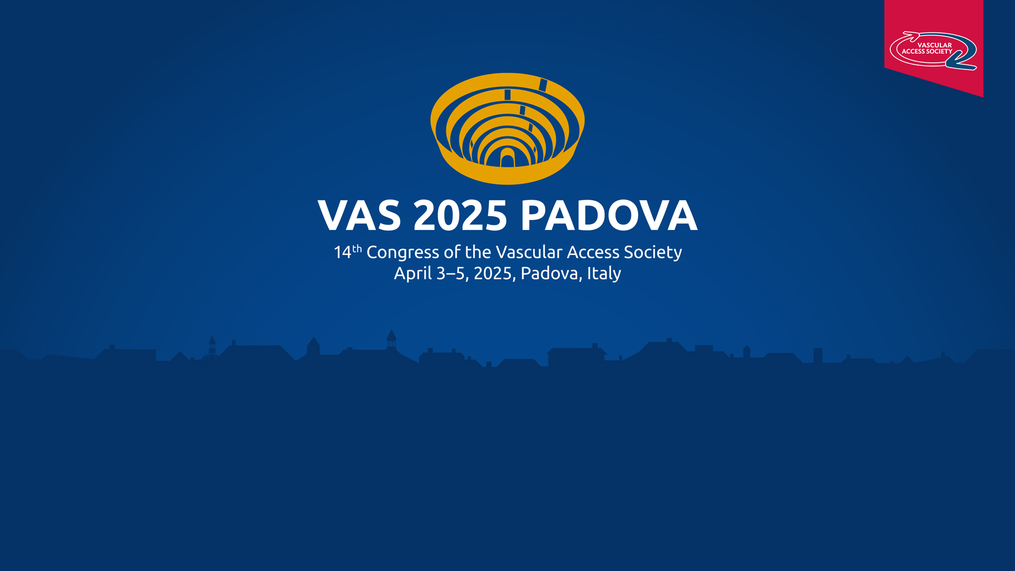
Vascular access management after kidney transplantation
Ulrika Hahn Lundström MD, PhD
Karolinska Institutet and University Hospital,
Stockholm Sweden
Notes:
VA management after KTx. UHL nephrologist clinical researcher from Stockholm

Slide 3
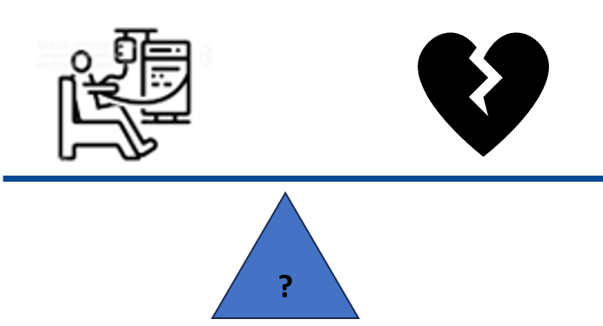
Vascular access management after kidney transplantation
Position paper on behalf of the Vascular Access Society and the European Kidney Transplant Association.
Barış Akin, Tamara Jemcov, David Cucchiari, Jan Malik, David Shemesh, Gavin Pettigrew, Ulrika Hahn Lundström, Gianluigi Zaza, Joris I. Rotmans
251114
Notes:
VA management after KTx. Published by tomorrow. To balance the risk for KF and future HD towards the future risk for HF. This question is increasing in importance with time, -due to the improved KTx graft survival in recent years, the 10-year kidney graft survival is now over 80% in Europe, We need to increase our awareness and knowledge on this topic. One first step common position paper VAS & EKTA, now under submission to JVA and Transplant Int .

Slide 4
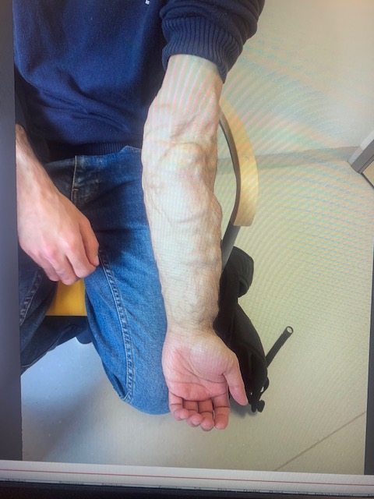
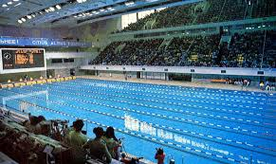
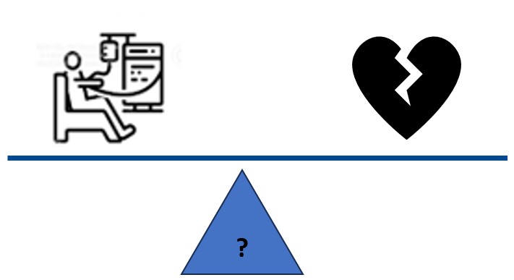
Vascular access management after kidney transplantation risk
1,5 liters/min=
1,5x60x24x365x3,17=2500000=
Olympic Pool på 3,17 år
Notes:
This KTx patient from Brazil in my out-patient clinic a few years ago, Revealed his arm an access flow of 5,5 l/min , CO 11 liters –we got it ligated.. Today there are no conclusive guidelines. Our KTx follow-up routine do not yet mention Accessflow/ echo. 1,5 liters/min= Olympic Swimming Pool in 3,17 years

Slide 5
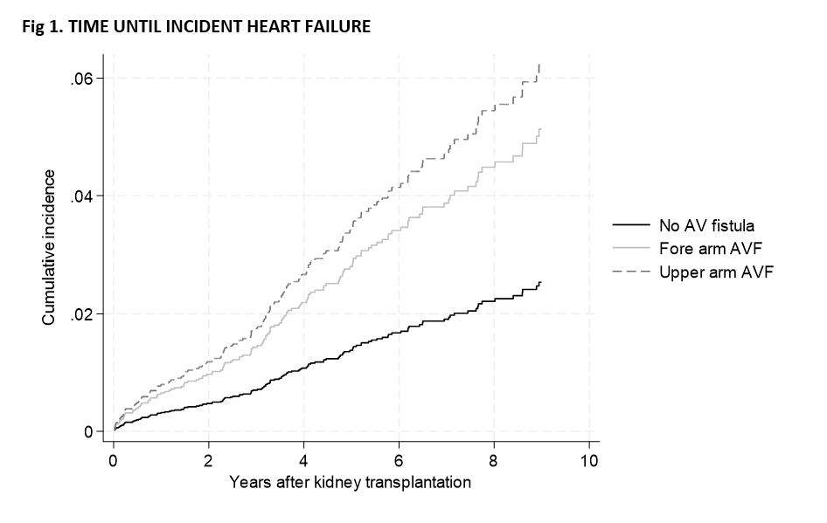
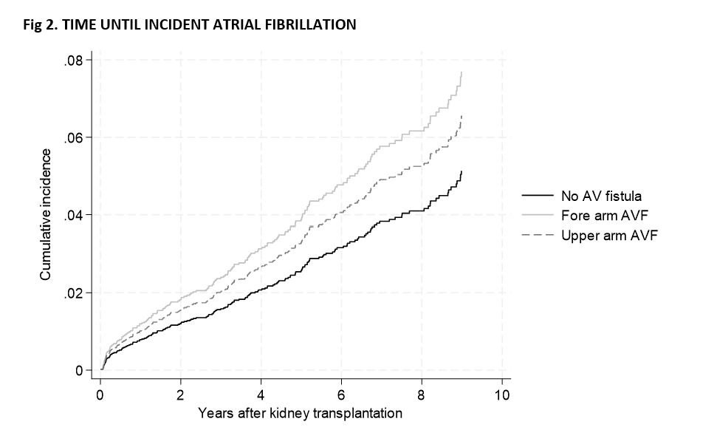
Kidney transplantation with a functional AV fistula is associated with
Long-term risk of de novo heart failure and atrial fibrillation
SRR; 2009-20
N= 3,361
AVF; n= 2236
Underarm AVF; n=829
Överarm AVF; n=296
U Hahn Lundstrom, M Evans
Notes:
SRR 3361 KTx 2009- 2020. To have a functional AVF at the time of KTx associated to long-term risk of de novo HF and atrial fibrillation., The adjusted HR of de novo HF was significantly higher for both low and upper arm AVFs compared to no AVF (2.22 [CI 1.52;3.24] (p<0.001) vs 2.55 [CI 1.56;4.15] (p<0.001)), De novo AF, a forearm AVF was associated with an increased risk (adj HR 1.57 [CI1.13;2.19]
HF there was no statistically significant difference between lower and upper arm AVF (p=0.08). AF: upper arm AVF was associated with a non-significantly increased risk (adj HR 1.34 [CI0.83;2.18].

Slide 6
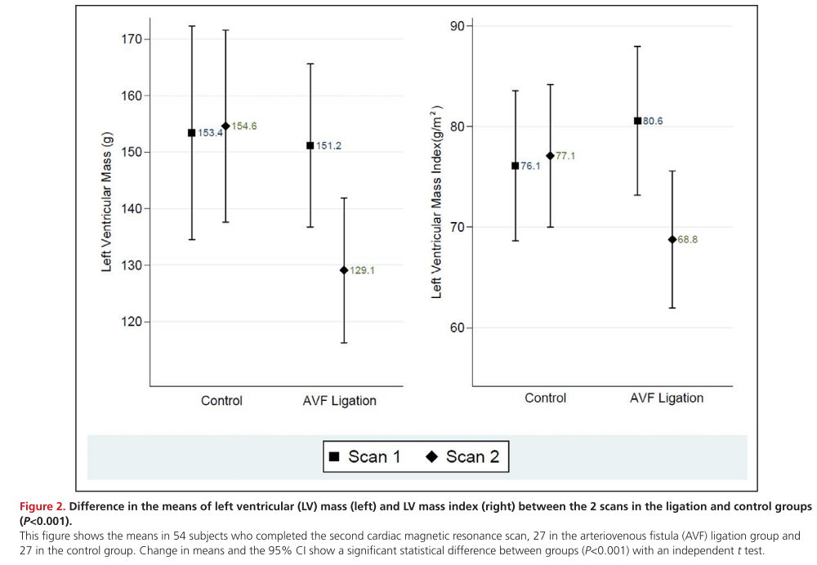
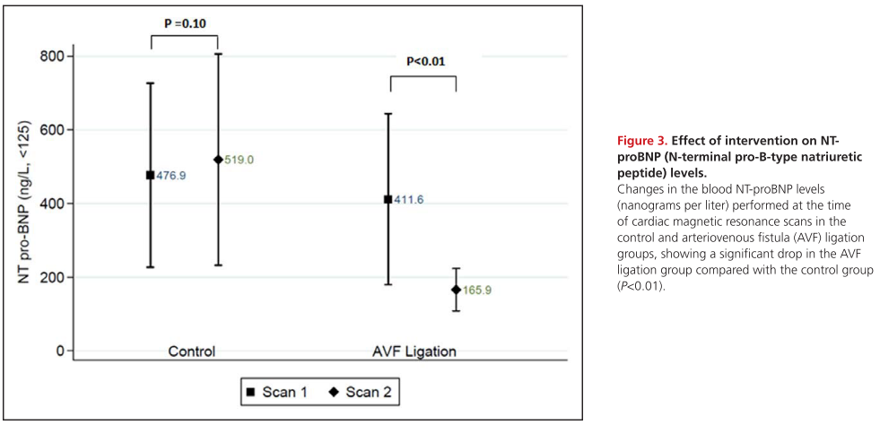
AVF ligation associated with a significant reduction in LV myocardial mass
Rao NN, et al. Effects of Arteriovenous Fistula Ligation on Cardiac Structure and Function in Kidney Transplant Recipients. Circulation. 2019;139(25):2809-2818.
Notes:
Randomized trial on elective AV fistula ligation associated with significantly reduced LV mass, CO, and NT-proBNP at 6 months. RAO
(Previous Meta-analysis supported AVF ligation superior long-term cardiac function and improved kidney graft function ZHENG)

Slide 7
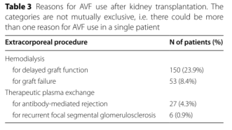
Patency not the same as use of AVA
Vajdic Trampuz B, et al. A national cohort study on hemodialysis arteriovenous fistulas after kidney transplantation- long-term patency, use and complications. BMC nephrology. 2021;22(1):344.
Notes:
There is a difference between AV fistula patency, and the actual need to use the AV fistula for HD after KTx graft failure, here only 8% in 5 years. Few studies on AV fistula patency. Similar AV fistula failure rates, 3/4 spontaneous thrombosis and 1/4 underwent AV fistula ligation.^{6,9} Unfortunately, spontaneous thrombosis occurs in the less cardiotoxic low-flow AV fistulas, the lower arm fistulas or AV grafts, and more often in females. ⁶

Slide 8
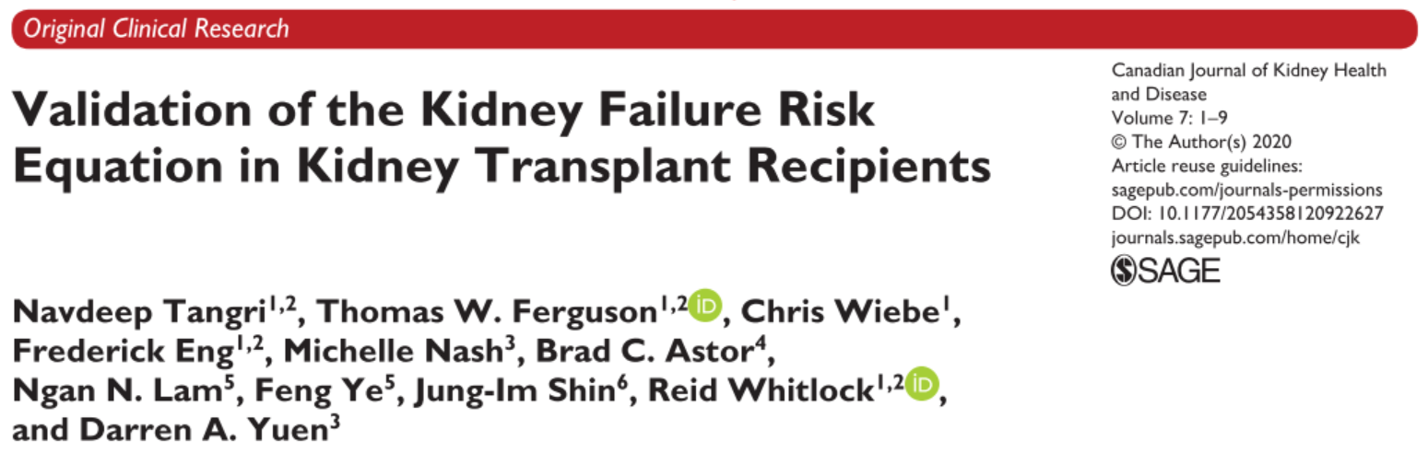
KFRE in KTx patients
Notes:
Later today we will talk about KFRE, it has been validated to risk predict KF also in the KTx,

Slide 9
Vascular access management after kidney transplantation
Position paper on behalf of the Vascular Access Society and the European Kidney Transplant Association.
Barış Akin, Tamara Jemcov, David Cucchiari, Jan Malik, David Shemesh, Gavin Pettigrew, Ulrika Hahn Lundström, Gianluigi Zaza, Joris I. Rotmans
Impact of AV access on the heart and circulation
Impact of AV access on Kidney allograft
Allograft Prognosis after KTx
Immunosuppression and VA- related aneurysmal complications
Chance of still having a functional AVF at time of allograft failure
Notes:
In the Postition paper we have really tried to cover all aspects; Impact of AV access on the heart and circulation- Impact of AV access on Kidney allograft- Allograft Prognosis after KTx -Immunosuppression and VA-related aneurysmal complications -Chance of still having a functional AVF at time of allograft failure

Slide 10
Vascular access management after kidney transplantation
Position paper on behalf of the Vascular Access Society and the European Kidney Transplant Association.
Barış Akin, Tamara Jemcov, David Cucchiari, Jan Malik, David Shemesh, Gavin Pettigrew, Ulrika Hahn Lundström, Gianluigi Zaza, Joris I. Rotmans
Benefits of maintaining a functional VA after KTx
Benefits of ligating a functional VA after KTx
Surgical techniques for intervention AV fistulas and grafts
Ligation of VA and reconstruction in future of HD: switch off and on
Notes:
Benefits of maintaining a functional VA after KTx - Benefits of ligating a functional VA after KTx- Surgical techniques for intervention of AV fistulas and grafts-Ligation of VA and reconstruction in future of HD switch off and on

Slide 11
Vascular access management after kidney transplantation
Position paper on behalf of the Vascular Access Society and the European Kidney Transplant Association.
Barış Akin, Tamara Jemcov, David Cucchiari, Jan Malik, David Shemesh, Gavin Pettigrew, Ulrika Hahn Lundström, Gianluigi Zaza, Joris I. Rotmans
Patient perspective
Current management of VA after KTx
Proposed protocol for management of VA after KTx
Conclusion- proposed surveillance program
Notes:
Patient perspective- Current management of VA after KTx- There is a Proposed protocol for management of VA after KTx- Conclusion-proposed surveillance program

Slide 12
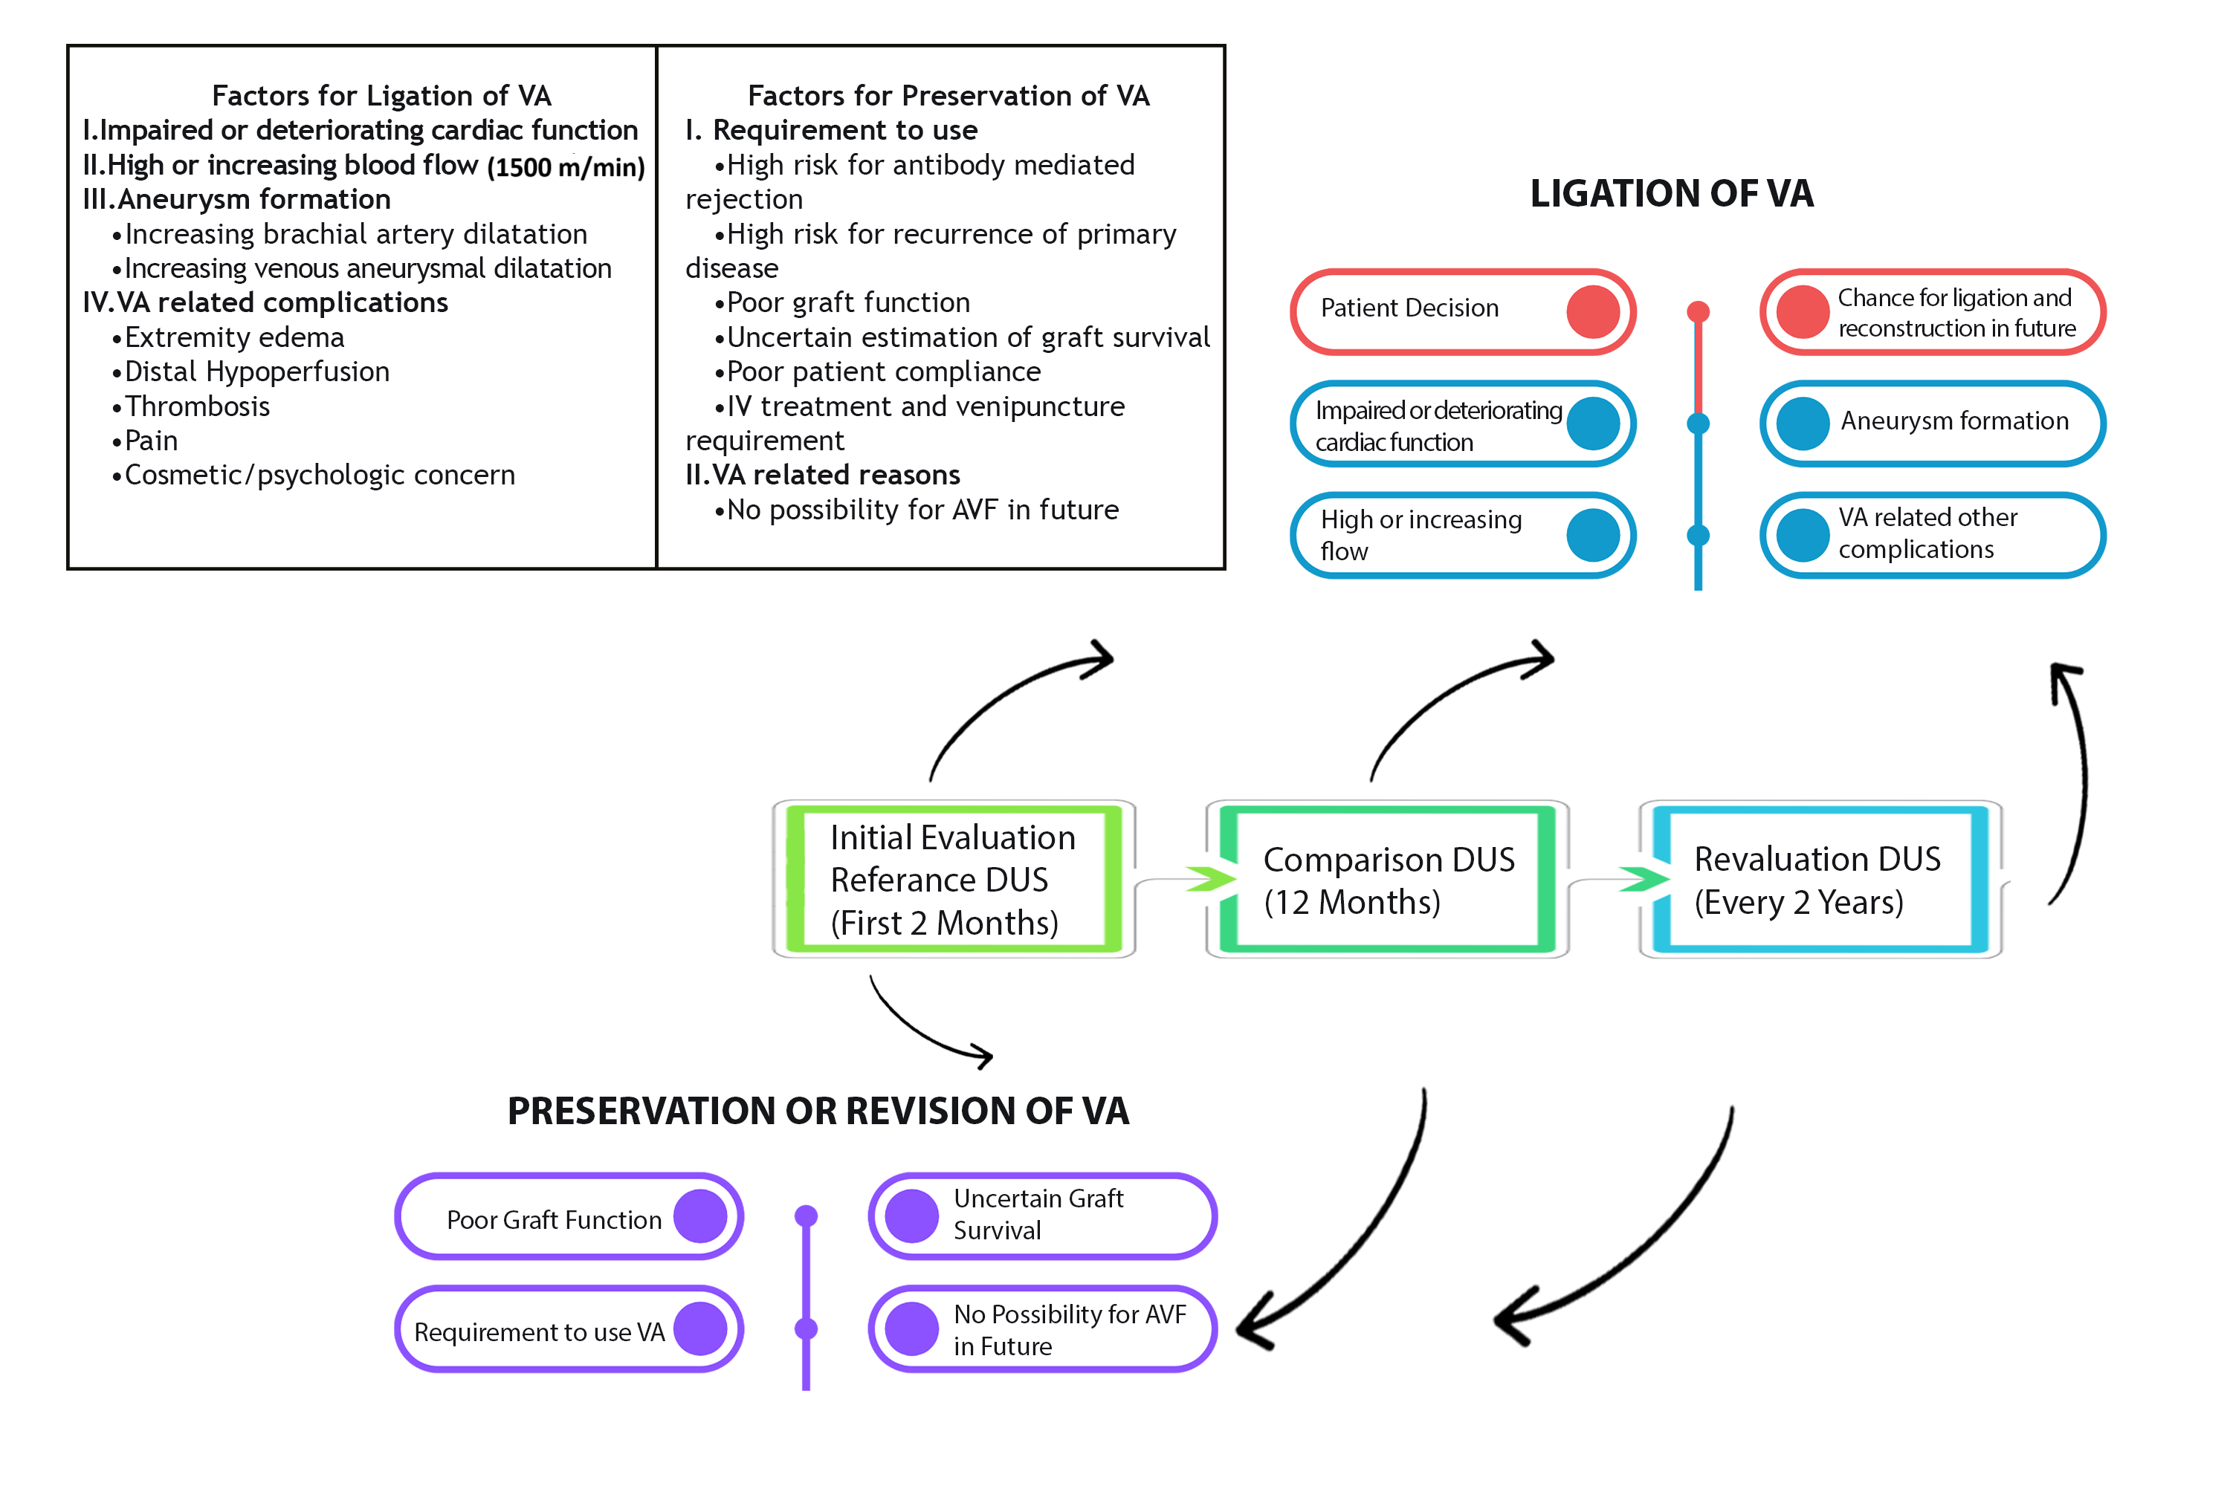
Vascular access management after kidney transplantation;
Position paper on behalf of the Vascular Access Soc. and the European Kidney Transplant Assoc. B Akin, T Jemcov, D Cucchiari, J Malik, D Shemesh, G Pettigrew, U Hahn Lundström, G Zaza, J I. Rotmans
251114
Notes:
The proposed surveillance program with factors for ligation and preservation of the VA. Evaluation at one year post KTx is crucial- High-flow accesses are >1500ml/min. Duplex ultrasound with an Initial evaluation- Comparison 12mths – every 2 years. Algorithm is not entrely evidense-based, represent the best available management strategy for detecting cardiac VA-related morbidity after KTx

Slide 13
Vascular access management after KTx- conclusions
VA of KTx recipients is a modifiable factor that significantly impact the heart disease
VA ligation reduces cardiac hypertrophy
Implementing a VA surveillance program is essential to improve KTx care
Favorable prognosis of KTx- AV ligation liberal- when well-functioning grafts
Decision of AV ligation by multi-disciplinary team with active patient participation
Thank you!
Notes:
VA in KTx recipients is a modifiable factor that significantly impact burden of heart disease- VA ligation reduces cardiac hypertrophy- Implementing a VA surveillance program is essential for improving VA management in KTx pts. Due to Favorable prognosis of KTx- AV ligation could be considered more liberally even without complication when well-functioning grafts- Finally Decision of AV ligation by multi-disciplinary team with active patient participation- Thank you!

