Slide 1
COVID-19 in Finland – focus on nursing homes
Kaisu Pitkälä
Professor, University of Helsinki
No conflict of interest

Slide 2
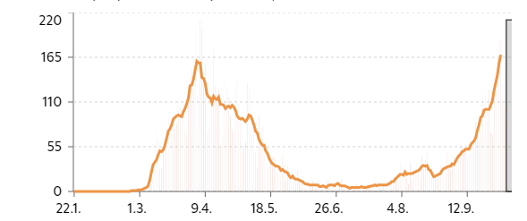
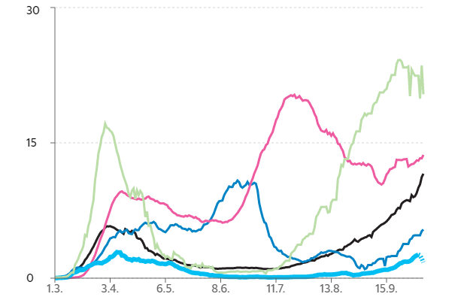
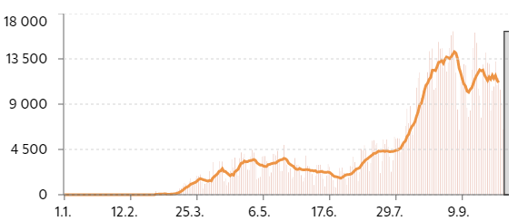
COVID-19 incidence, DEATHs in FINLAND compared to other countries
New cases /day
Total nro by Oct 8th, 2020
Cases Deaths
FINLAND 11 049 346
SWEDEN 96 677 5 892
EUROPE 5 520 666 227 618
Tests / day
Spain
USA
Europe
Sweden
Finland
New cases / 100 000
Notes:
0.5% of the tests in Finland are positive
E.g. In Belgium the respective figure is 7%
Finland strategy to combat COVID-epidemic has been: test, trace, isolate and treat.
The development in death, in numbers of those in hospitals or in emergency care has been modest_
Hospitalized 31 inOct 8, emergency care 5 patients

Slide 3
COVID-19 hits nursing homes hard
The proportion of nursing home population is 1% in various countries
The nursing home population accounts for 31-85% of all COVID-19 deaths
Mortality among infected NH residents is about 30-40%
By June- Aug 2020 | % infected of NH population | % of all deaths in country | Mortality in NH population
Finland | 0.6% | 34% | 0.3%
Sweden |  | 47% | 2.8%
Great Britain |  | 45% | 7%
Netherlands | 10% | 32% | 2%
France |  | 49% | 2.4%
Germany |  | 39% | 0.4%
Italy |  |  | 3(-8)%
Spain |  | 34-68% | 6%
Belgium | ~4% | 50% | 5%
Canada | 4% | 85% | 1.5%
USA |  | 45%
Notes:
Although all do not die, only 10% will fully recover. The other will suffer from functional decline
The comparison is difficult since some include confirmed cases, some suspected cases,.
Reasons for differences:
Finland was 2 wks behind others and time to arrage lockdown.
Some countries have common bedrooms, hospital like spaces
Large vs small care homes – 1000 vs 15 residents . How crowed is the country?
Culture is different – more socializing?
How much medical support? How educated is staff? Quality of care in NH
Some countries made mistakes in their policy.
England declared lockdown quite late 26.3.2020
The Netherlands has well developed long-term care sector with NH specialized geriatricians in charge of NHs and each NH having their own hygiene committe and internal crisis team. However, the government gave instructions that
Staff were allowed to work in cold symptoms without fever
There were restrictions in use of PPE
Restrictions in testing policy.

Slide 4
Why in nursing homes?
Extremely vulnerable population (multimorbidity, frailty, high age, waning immunity, atypical symptoms and difficulties isolating)
Close contacts: sharing bathrooms, dining and group activities, wandering residents, ”high touch care”
NH staff (high turnover, infected people work, deputies transmitting, low education and low salary (may work in several places), visitors, asymptomatic people as transmitters), low resourses compared to other health care sector
Shortage of personal protective equipment and low testing capacity at the begining of epidemic
Admissions to hospitals; hospitals admit back because of shortage of beds

Slide 5
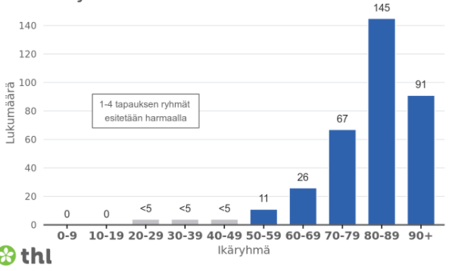
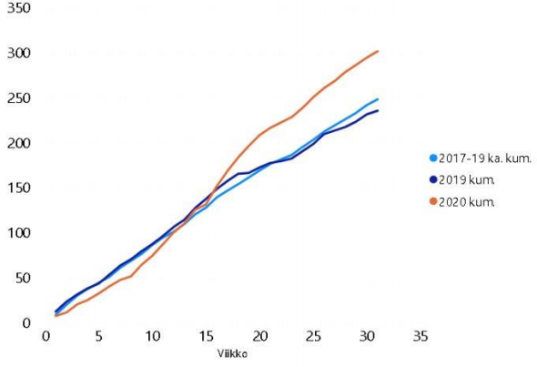
Long-term care in finland…
Consists of 4200 NH beds and 38841 assisted living facility beds
Residents are living their last years of life, >80% suffer from dementia
247 residents had confirmed COVID -19 infection (0.6%). Of them, 34% died.
70+ year-olds account for 88% of all deaths
The total mortality in Finland has not increased during COVID-19 period
Deaths in Espoo NHs
Notes:
The

Slide 6
Timeline of covid-19 spread in finnish nursing homes
26.2.2020
The first confirmed COVID case in Finland
17.3.2020
Visits to NHs banned
21.3.2020
The first COVID-19 death in Finland
End of March
First COVID cases in NHs
April
Various restrictions in NHs
Notes:
Finland followed some weeks behind the other European countries in the first wave of COVID-19 and, thus, had a bit more time to prepare.
WHO announced COVID-19 as a pandemic 11.3.2020
A day later FInnish Institute for Health and Welfare gave instruction: If you are unwell ….phone your grandparents instead of visiting them. Furthermore, a recommendation was given to 70+ older people to remain away from a physical contact with other people. The older people took this very seriously. One of the main aims in COVID strategy has been to protect older people from infection.
Finland quickly introduced strict recommendations, legistlations and also emergency powered law. The purpose of restricting many fundamental rights of citizens was to slow the spread of infection in population but also to help to prevent overburden of the health care system.
A week after WHO declaration of COVID-19 pandemic the visits to long-term care facilities were banned except for those visiting their loved ones for terminal care. At the same time school transferred to distance learning and students stayed at home school.

Slide 7
Timeline of covid-19 spread in finnish nursing homes
26.2.2020
The first confirmed COVID case in Finland
17.3.2020
Visits to NHs banned
21.3.2020
The first COVID-19 death in Finland
End of March
First COVID cases in NHs
April
Various restrictions in NHs
- Group activities stopped
Dining in small groups or own room
Recommendations to stay in own room
Quarante for newcomers or those returning from hospital
Notes:
First COVID death appeared as early as 21. march whereafter several restrictions were introduced. Residents were no longer able to eat in dining rooms. Relatives were stronly recommended to take contact by phones, tablet or sending letters or postcards.
There were concerns about adverse effects of residents’ lockdown.

Slide 8
Timeline of covid-19 spread in finnish nursing homes
26.2.2020
The first confirmed COVID case in Finland
17.3.2020
Visits to NHs banned
21.3.2020
The first COVID-19 death in Finland
End of March
First COVID cases in NHs
April
Various restrictions in NHs
May
Restrictions could be released
Notes:
Fortunately the first COVID 19 wave was easing up already at the beginning of May. And the restrictions could be released before summer.
At first visitors could meet residents outside and e.g. special meeting places with protective shields were organised.

Slide 9
What did the Nursing homes do in finLand?
The NHs and units received detailed instructions and training
Handwashing, coughing etiquette, distancing, using PPEs
Cleaning and desinfection
Pauses and meals of staff were done stepwise
All meetings were arranged online
The NHs were supported by mobile ”pandemic teams” or hygiene nurse, focusing on infection control
All, even mild infections (both residents and staff) were to be reported
Notes:
The units received enough PPEs as late as 9.4.
A working group to map the need for PPEs was founded and they made a plan + priorizations

Slide 10
What did the Nursing homes do in finLand?
The units sticked to staff they had and mobile deputies were avoided
Some staff was recruited from discontinued operations
The visitors were banned except for those residents in end-of-life care
Tablets, phones, letters etc were encouraged contact means
Group activities, common dining stopped. Residents were recommened to stay in their own rooms as much as possible
The units were refurnished to enable social distancing
When NHs were opened up again, visitors were coached/reminded in use of PPEs, washing hands, desinfectants etc.

Slide 11
What did the Nursing homes do in finLand?
All new residents and those returning from hospitals were screened and had to stay 14 days in quarante
When an infection was detected, all other residents and whole staff was tested
The COVID19 cases were taken care in isolation from others
Hospital-at-home supported these units and took care of these patients
Cohort units were founded but they were not needed

Slide 12
What next? 2nd wave is at the door…
Infections is not the only problem
After quarantene older people suffer from
Loneliness → cognitive decline
Immobility→ frailty, disabilities
Other chronic diseases do not receive attention and their treatment has been postponed
Staff suffers from stress, fear, anxiety and mourning → need for support, education and good resources

Slide 13
What can we do?
”Test–trace–isolate–treat” are the cornerstones of strategy
There are asymptomatic and atypical cases →
Low threshold for mass testing to limit outbreaks
Hygiene, PPEs and safety measures must be implemented
Monitors visitors, register cases and places
The staff needs support – 24/7 online platforms seems to be feasible.
Consequence of prevention should be no worse that infection itself!

Slide 14
How to prevent cognitive and functional decline?
We must balance between the COVID-19 and adverse effects of prevention
Allow visits and educate relatives in safe meetings as far as possible
Individualised physical exercise to combat functional decline
Social rehabilitation e.g. we use E-platforms (Circle-of-Friends®) for group activities
On guidance, please see: Blain et al. Eur Geriatr Med 2020; AGS Policy Brief; JAGS 2020;68:908-11.
Notes:
They say that in May 2020 Finns met 75% less people than normally. It may be also argued that it is not so difficult for Finns to keep social distancing. However, how far we can continues with this?

Slide 15
Thank you for your attention!

